Slide 1
Secure Operating Systems
Samuel OCEN
E MAIL: - samuel.ocen@mmu.ac.ug
samuel.ocen@student.uonbi.ac.ke
MOB: - +256(0)775 679 505
+256(0)706 109 393

Slide 2
Overview
Data Execution Prevention
Address Space Layout Randomization (ASLR)
Structured Exception Handler Overwrite Protection (SEHOP)
User Account Control (UAC)
DNS System Security Enhancements (DNSSEC)

Slide 3
Data Execution Prevention
Data Execution Prevention (DEP) is a system-level memory protection feature that is built into the operating system starting with Windows XP and Windows Server 2003.
Data Execution Prevention (DEP) is a memory-protection feature in Microsoft Windows that prevents malicious code exploits. It monitors certain memory regions or pages and prevents them from executing malicious codes.
DEP uses hardware and software-based mechanisms to ensure that the system memory locations are used only by Windows and other authorized applications.

Slide 4
Operation of Data Execution Prevention.
Unlike a firewall or an antivirus suite, DEP can’t prevent malware from being installed on your computer. It’s only a security tool that monitors programs on the computer and ensures that they utilize the system memory safely.
DEP achieves this by marking one or more memory locations as non-executable. A non-executable location means that code can’t be executed from that memory region, thus reducing the threat of malicious code exploits.

Slide 5
Operation of Data Execution Prevention.
In case an application attempts to execute code from one of the protected memory regions, a memory access violation occurs, and the user is notified. If the user doesn’t handle the violation, the process is terminated.
A downside of using DEP is that it may sometimes flag programs that rely on Microsoft Windows services. You’ll either have to disable DEP or create an exception for the program in your system settings to run such programs.
However, this would make the program vulnerable to attacks that could then spread to other programs and files on your computer.

Slide 6
Types of DEP.
Data Execution Prevention can be enforced by both hardware and software to help prevent malicious code execution. Here is how the two differ:
1. Hardware-Enforced DEP
Hardware-based DEP marks all memory locations as non-executable unless a location explicitly holds the executable code. It relies on the processor hardware to distinguish memory locations where code shouldn’t be executed.
DEP's hardware-based implementation varies with processor architecture, but all processors that support "execution protection" can enforce hardware-based DEP against malicious exploits. Both AMD and Intel make processor architectures compatible with DEP.

Slide 7
Hardware-Enforced DEP Requirements
The computer processor should be compatible with DEP.
Hardware-enforced DEP should be enabled in the BIOS.
Hardware-enforced DEP should be enabled for programs on the system.
2. Software-Enforced DEP
Software-enforced DEP is a memory protection technology designed to prevent code exploits that leverage Windows' exception handling mechanisms. Any processor capable of running Windows XP Service Pack 2 (SP2) and above can run software-enforced data execution prevention.

Slide 8
How to Enable DEP in Windows 10 and 11.
Using System Settings
Using the Settings menu is the most straightforward way to enable DEP on your Windows machine. Here's what you need to do:
To get started, click Start and select Settings.
Type View Advanced System Settings and choose the same option in the drop-down menu.
Tap on Advanced in the new window and select Settings under the Performance section.
Click on Data Execution Prevention in the menu bar and check the box against Turn on DEP for all programs and services only option.
Apply the changes and click OK to complete the process. You may also need to restart the system for the changes to take effect.
You can also exclude certain programs from DEP protection by choosing Turn on DEP for all programs and services except those I select. As soon as you check the box against this option, you'll be able to add programs and services to the list that won't use DEP.
Additionally, the data execution prevention window also tells you whether your processor supports hardware-enforced DEP.

Slide 9
Using Command Prompt
Alternatively, you can use Command Prompt, which is actually a one-step process provided you know the command line. Follow the steps below:
To enable DEP through the Command Prompt, click Start and type CMD in the search box.
Right-click on Command Prompt and select Run as administrator.
In the Command Prompt window, type BCDEDIT/dbgsettings and press Enter.
The changes will take effect as soon as you restart your computer.
BCDEDIT - Boot Configuration Data Store Editor

Slide 10
Address Space Layout Randomization (ASLR).
Address space layout randomization (ASLR) is a technique that is used to increase the difficulty of performing a buffer overflow attack that requires the attacker to know the location of an executable in memory.
A buffer overflow vulnerability is a flaw in software written in a memory-unsafe programming language, such as C.
Such a flaw is characterized by a failure of an application to validate the size of user input data that is written to memory.
An application can remedy this flaw by checking the length of the user input data and throwing an exception or issuing an error message if the actual length does not match the expected length.

Slide 11
Enabling ASLR
By default, ASLR is disabled. To enable ASLR, either IPL the system using a DIAGxx member that specifies the ASLR option or issue the SET DIAG=xx command after IPL.
If you enable ASLR after IPL, only those jobs that are subsequently started and that are not exempt from ASLR will have ASLR enabled.
The ASLR enablement options provide a way to restrict ASLR to subsets of address spaces where it is less likely to cause a storage constraint issue.

Slide 12
Impact of ASLR on virtual storage
The decision to enable ASLR represents a tradeoff between enhanced security and a reduction in the amounts of available 24-bit, 31-bit, and 64-bit private storage.
When enabled for 24-and 31-bit virtual storage, the size of available private storage will be reduced by up to 63 pages and 255 pages, respectively.
A job’s requested region size must still be satisfied from within the reduced private area in order for the job to be started. Jobs whose region size cannot be satisfied will result in an ABEND 822.
If a job’s requested region size is satisfied, it is still possible that the reduced size of private storage prevents the job from completing, resulting in an ABEND 878.

Slide 13
Impact of ASLR on virtual storage continued.
One way to determine whether jobs would not be able to run under the constrained size of 24- or 31-bit private storage that would occur with ASLR enabled is to specify a larger value for the CSA parameter in parmlib. Increasing the sizes of both 24- and 31-bit CSA by 1M effectively reduces the sizes of 24- and 31-bit private storage by 1M, which is greater than the maximum reduction that would occur under ASLR.

Slide 14
Structured Exception Handler Overwrite Protection (SEHOP)
Structured Exception Handling Overwrite Protection (SEHOP) helps prevent attackers from being able to use malicious code to exploit the Structured Exception Handling (SEH), which is integral to the system and allows (non-malicious) apps to handle exceptions appropriately.
Click Start, click Run, type regedit, and then press ENTER.
Locate the following registry subkey:
HKEY_LOCAL_MACHINE\SYSTEM\CurrentControlSet\Control\Session Manager\kernel\DisableExceptionChainValidationNote If you cannot find the DisableExceptionChainValidation registry entry under the HKEY_LOCAL_MACHINE\SYSTEM\CurrentControlSet\Control\Session Manager\kernel\ subkey, follow these steps to create it:
Right-click kernel, point to New, and then click DWORD Value.
Type DisableExceptionChainValidation, and then press ENTER.
Double-click DisableExceptionChainValidation.
Change the value of the DisableExceptionChainValidation registry entry to 0 to enable it, and then click OK. Note A value of 1 disables the registry entry. A value of 0 enables it.
Exit Registry Editor.

Slide 15
User Account Control (UAC).
User Account Control (UAC) is a fundamental component of Microsoft's overall security vision. UAC helps mitigate the impact of malware.

Slide 16
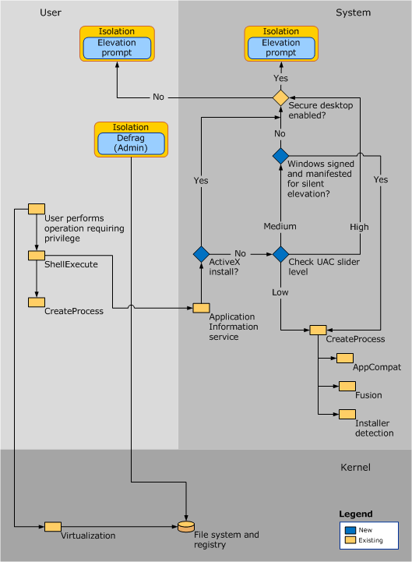
User Access Control (UAC).

Slide 17
DNS System Security Enhancements (DNSSEC).

